Slide 1

The Phenomenon of Relevance
Teaching Forensics with Personal Connection and Reality
Notes:
Photo Credit: https://www.kickassfacts.com/25-awesome-natural-phenomenon/
The last thing this class needs to be is Ferris Beullar’s teacher…”Bueller, Bueller, Bueller”

Slide 2

Bethany Hayes
Bachelor of Science in Chemistry and a minor in Criminal Justice from Valdosta State University
Dreamed of a job with the GBI, FDLE or ATF
Forensics Teacher at Thomas County Central
Notes:
Photo credit: https://clipartion.com/free-clipart-14788/
Witnessing a death by car accident made me change my mind from trauma doctor to medical examiner.
College made me want to be a crime scene investigator or a field agent with the ATF.
Eager to respond to Laura’s email about interest in teaching Forensics.

Slide 3
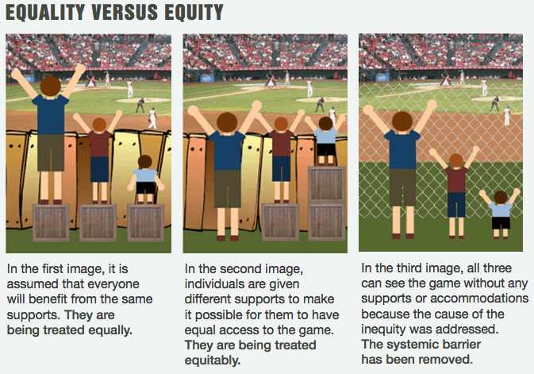
Notes:
Slide 3: https://www.diffen.com/difference/Equality-vs-Equity
Candy example:
Everyone stand
Sit down if you are allergic to the candy you chose
Sit down if you do not like the candy you chose
Sit down if you are over 40
Sit down if you have brown eyes
Those remaining standing can eat your candy.
Sometimes the limitations our students face are related to school. Sometimes they have absolutely nothing to do with school but it still affects their learning.

Slide 4

Bias
What impacts our students?
What is their perception?
What is their truth?
What do our students have to overcome?
Our own backgrounds and opinions impact our teaching of this course.
Notes:
Photo Credit: https://www.extremetacticaldynamics.com/blog/can-civilians-use-police-flashing-lights-guide/“your perspectives become your reality”
If left to believe your own perspectives, especially when they are inaccurate, they will become a self-fulfilling prophecy.
Poll the audience about their background / certification. Maybe tell Leonard’s story about being pulled over at 17.

Slide 5

Superhero
How do we help them overcome it?
Do we have a responsibility to help them overcome it?
What good does it do to teach them the science if we do not help them overcome their misconceptions?
Notes:
Photo Credit: https://webstockreview.net/explore/cape-clipart-wind/

Slide 6
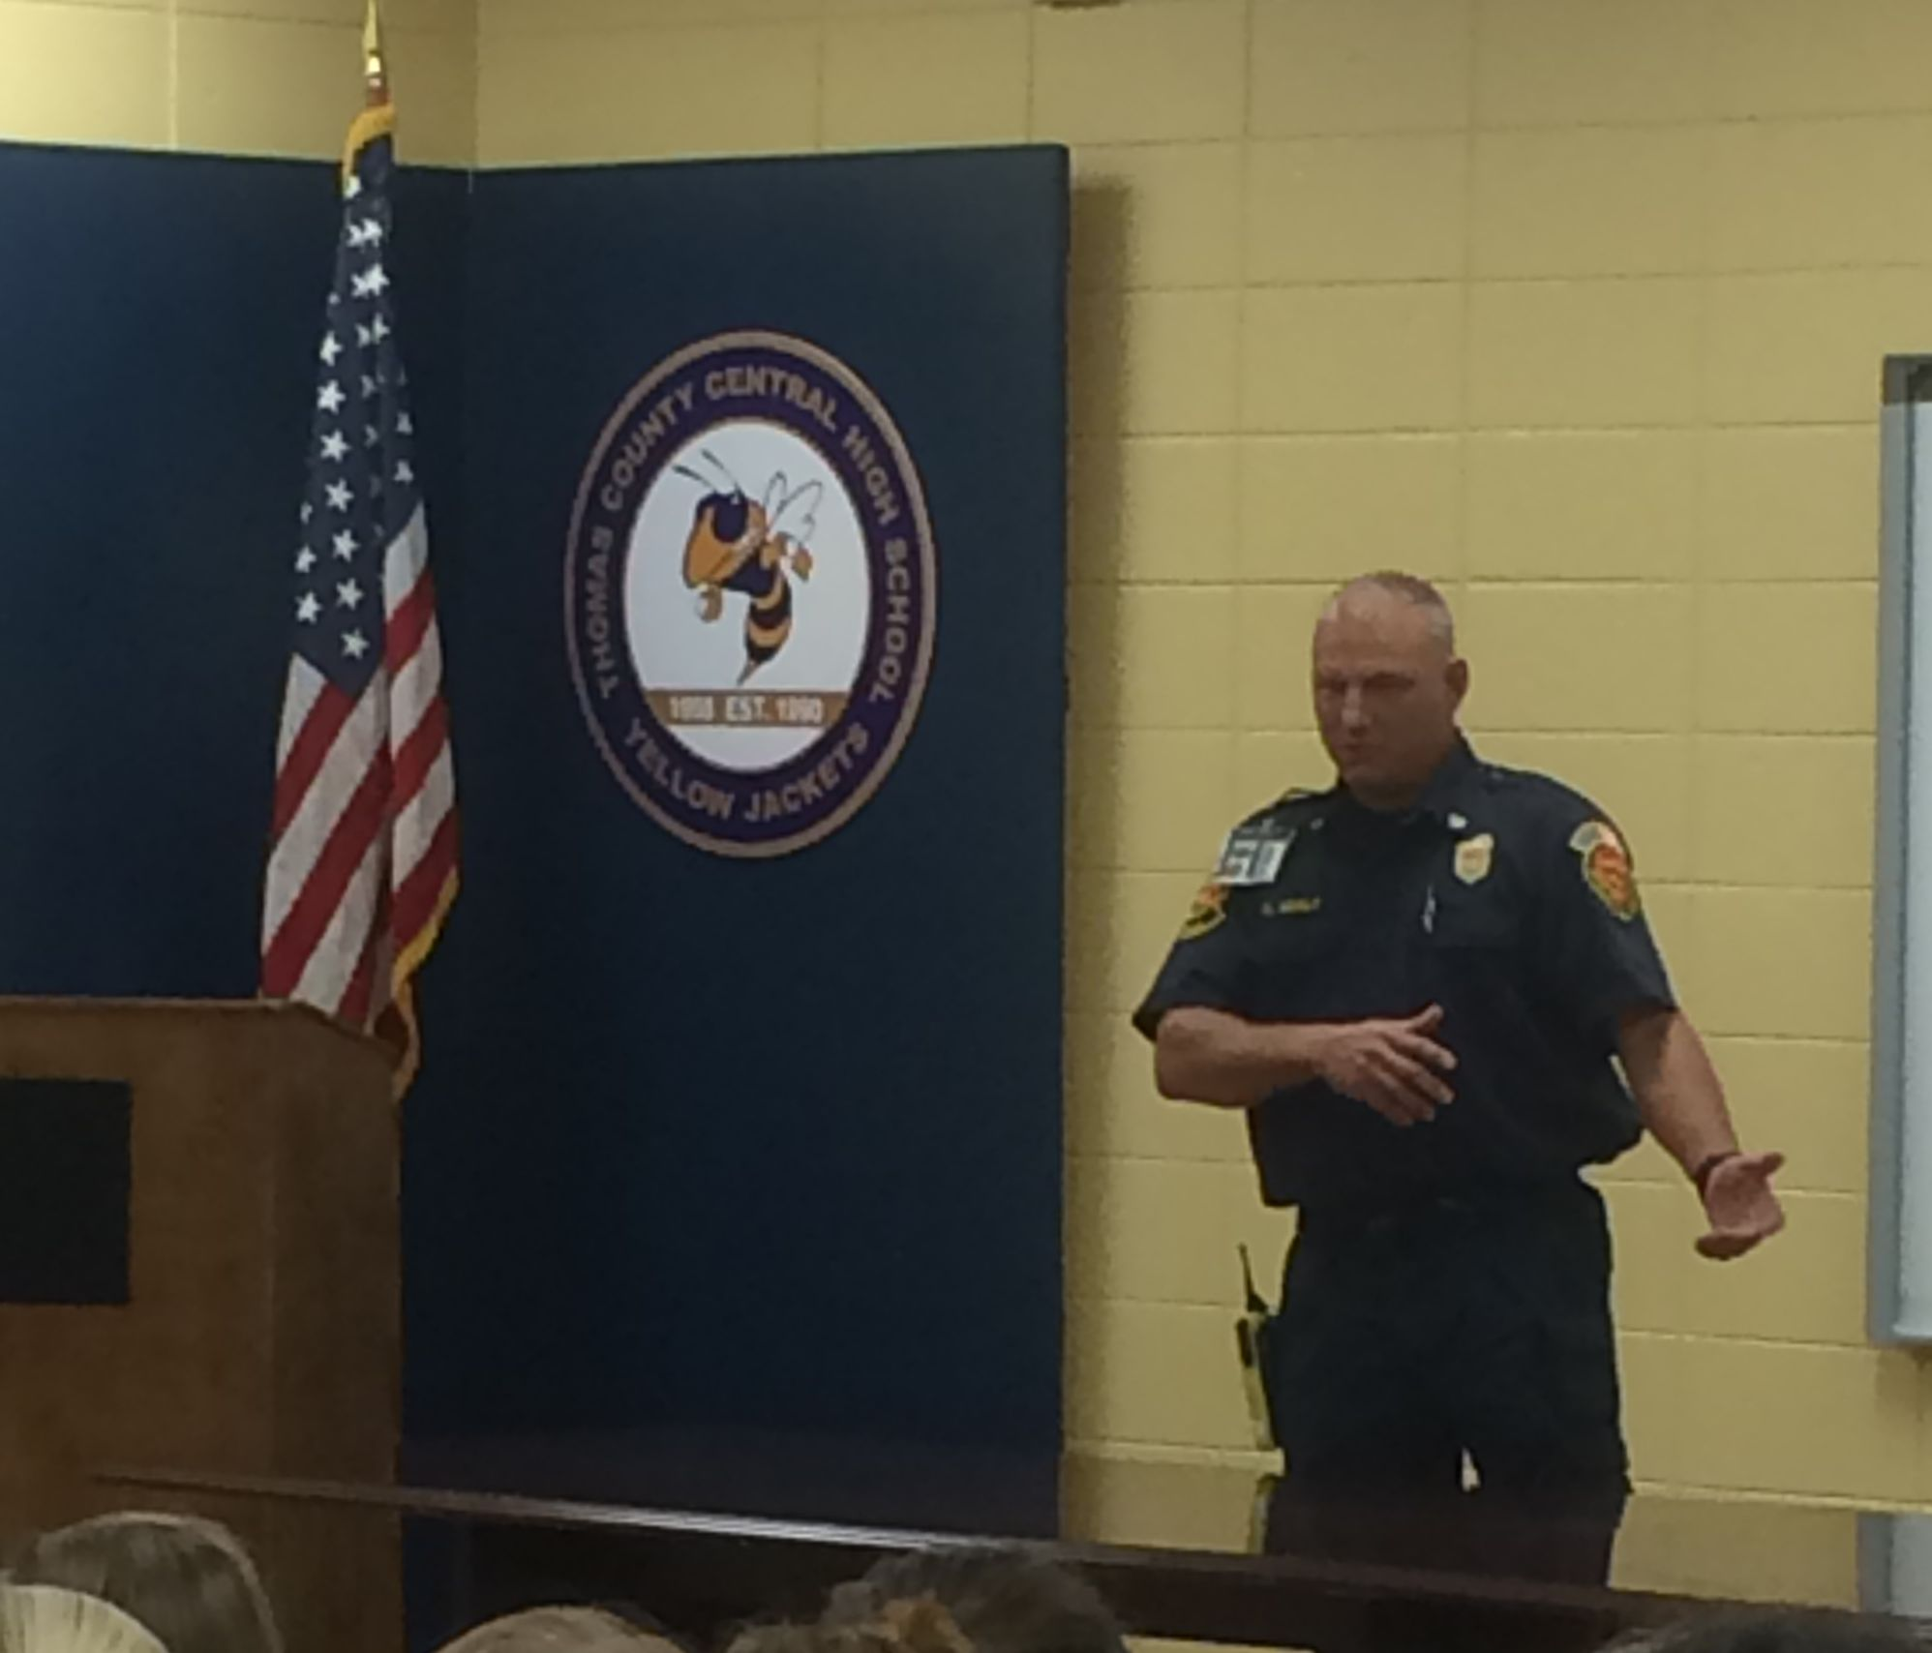
Field Trips / Speakers
GPSTC
Georgia Crime and Punishment Museum
Local EMTs, Fire Chiefs, Coroner, SRO, Police or Sheriff’s Office
Notes:
https://www.gpstc.org/
https://www.exploregeorgia.org/ashburn/arts-culture/cultural-trails-tours/crime-and-punishment-museum

Slide 7
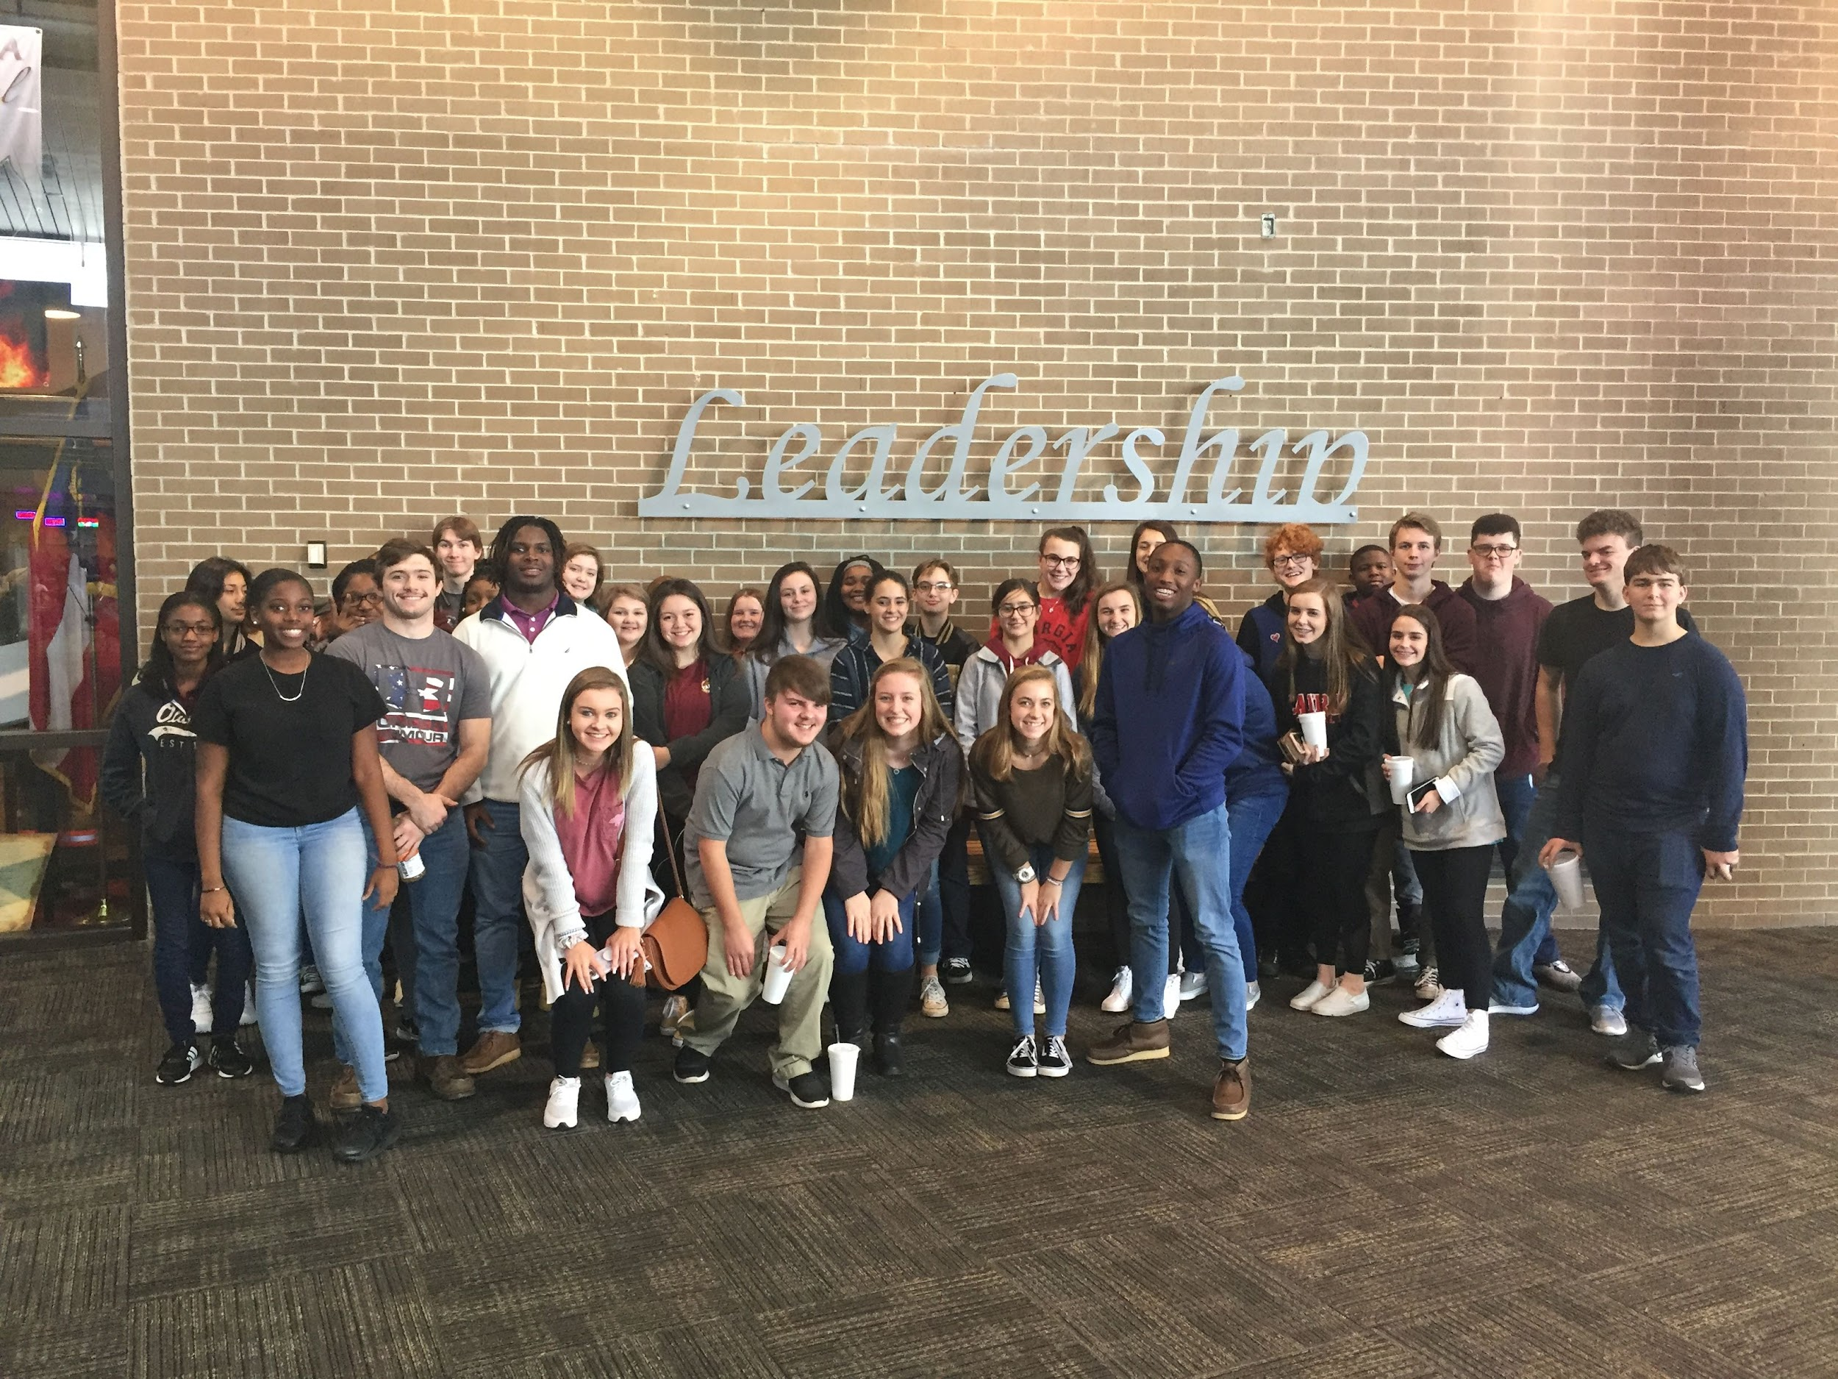

Slide 8
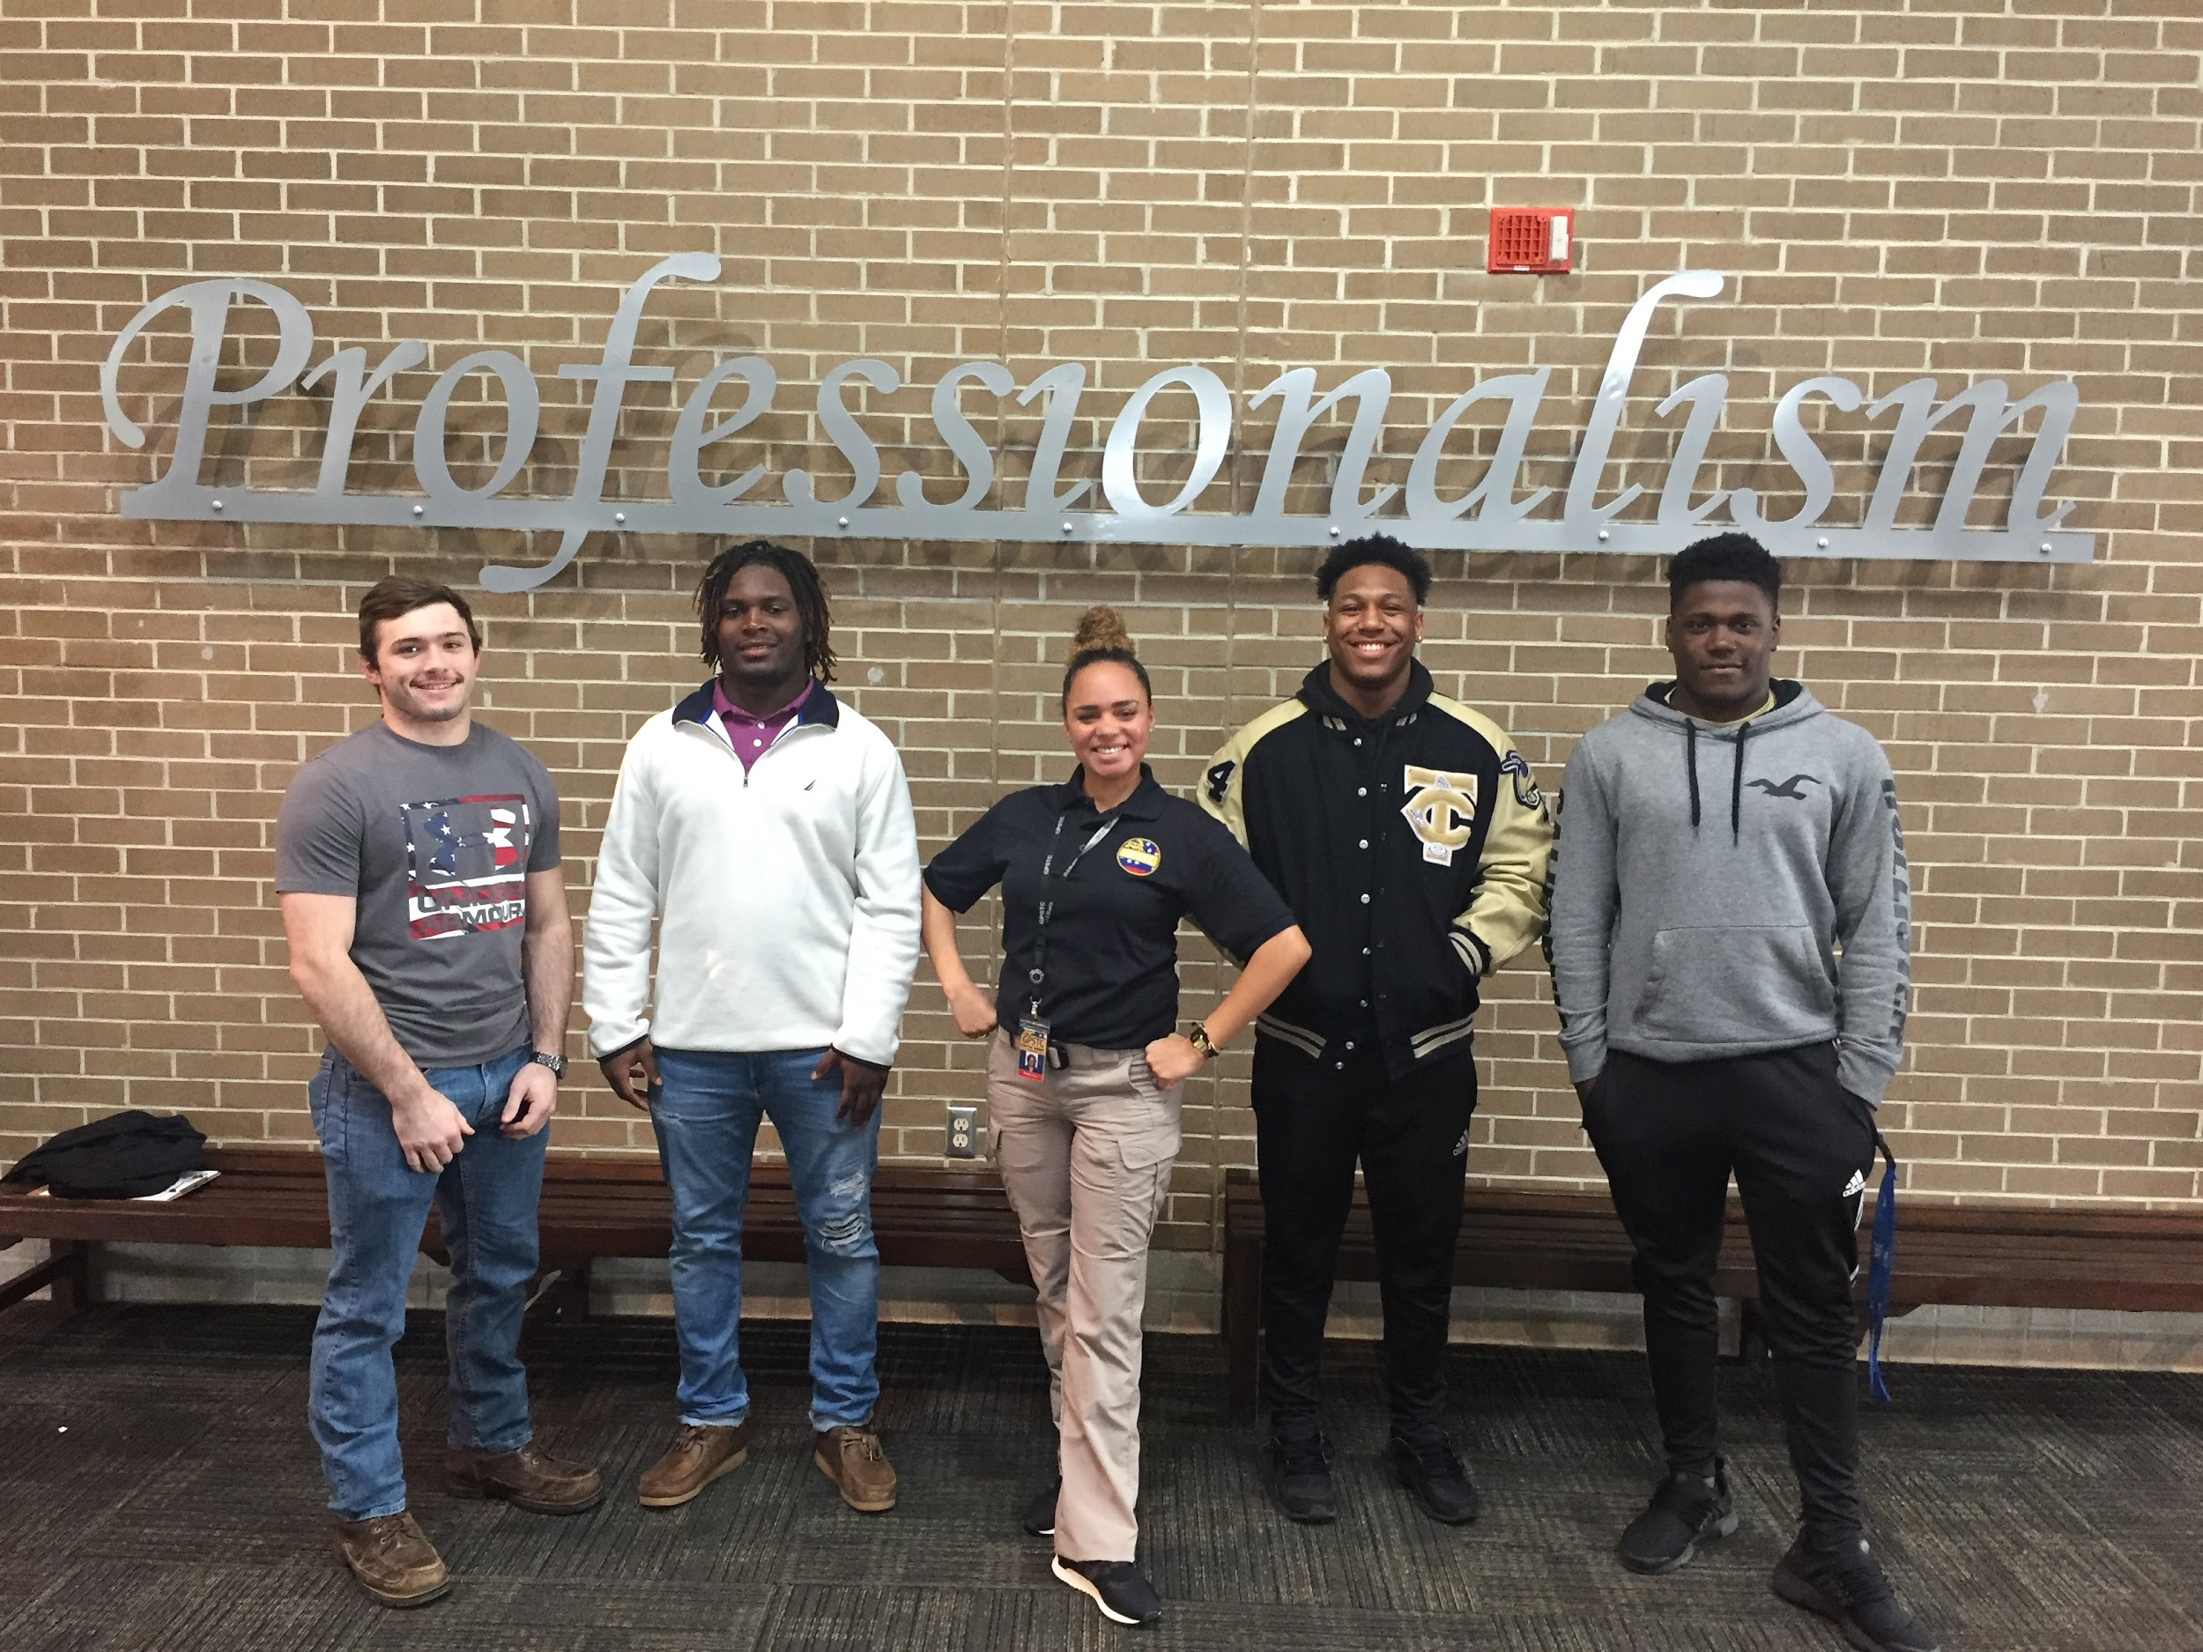

Slide 9
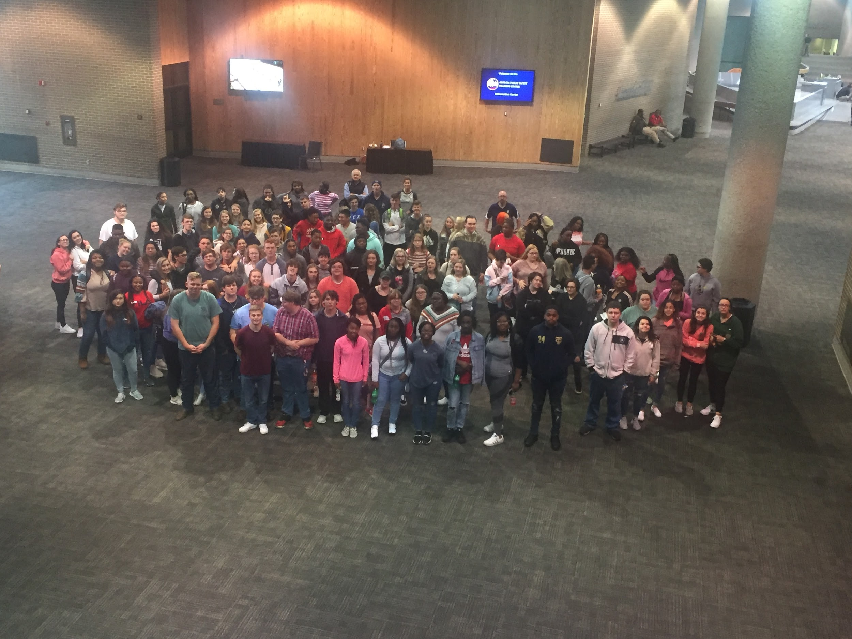
Notes:
At lunch, a student noticed a convict bussing tables in the cafeteria and became anxious. I reminded her that of the 300+ people in the cafeteria, we were the only ones who were not cops and that she had never been nor would she ever be as safe as she was right then.

Slide 10
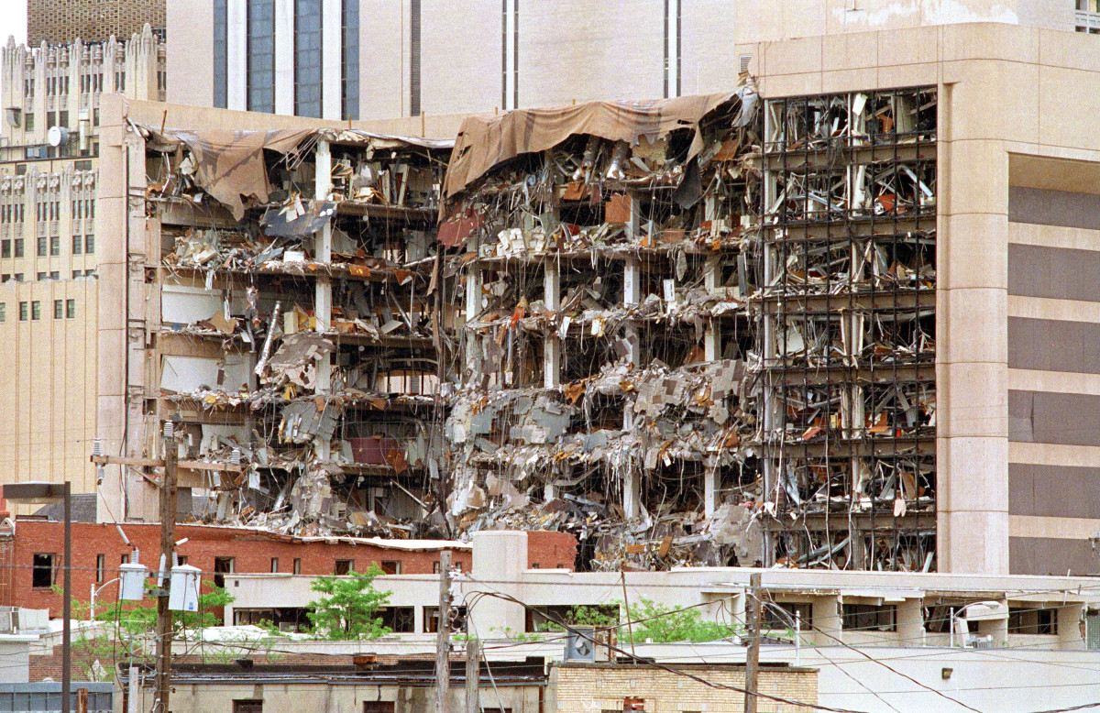
Real Examples
Notes:
Photo Credit: https://www.history.com/topics/1990s/oklahoma-city-bombing
When I asked the kids what was the first thing they think of when I mention a bombing, their responses were split between the Boston Marathon Bombing and 9/11. I actually have to explain to them that 9/11 was not a bombing…
So we study Timothy McVeigh and Terry Nichols as if we are members of a task force looking for an unsub. Then I show them the video to Garth Brooks “The Change” https://uploadstars.com/video/7H7S3WYRX8M3
I got roofied on my honeymoon in Mexico.
Lorie was roofied in Jacksonville.
Chris was roofied in New Orleans.
Brad never has an open container for fear of being roofied.
How to hold your cup in college.
My parents checked my car tires and wheel wells in high school for clay.
How to behave in a traffic stop.
Drug Songs (https://docs.google.com/presentation/d/1NT6_DmuoYqAhE8bn9rNk_74aTZYgR-H1LPz7mC1-3b4/edit?usp=sharing)
Oklahoma City Bombing vs. Boston Marathon Bombing

Slide 11

Truth
The importance of respecting a different opinion
Their fears are not irrational to them
You may have to ask them to share and encourage them to educate their classmates
Notes:
Photo credit: https://www.kissclipart.com/truthfulness-clipart-lie-truth-polygraph-n8bxkq/
What makes a fear irrational? Is it irrational to the person who is afraid?
Ry’mya, “radical” tshirts, first week of school, I asked her to share with her classmates as the year continues

Slide 12

Debates and Discussions
Notes:
Photo Credit: https://www.nicepng.com/maxp/u2r5r5q8y3w7w7t4/
Gun Control, only after they have learned all they can learn.
Mock testimony on credibility.

Slide 13
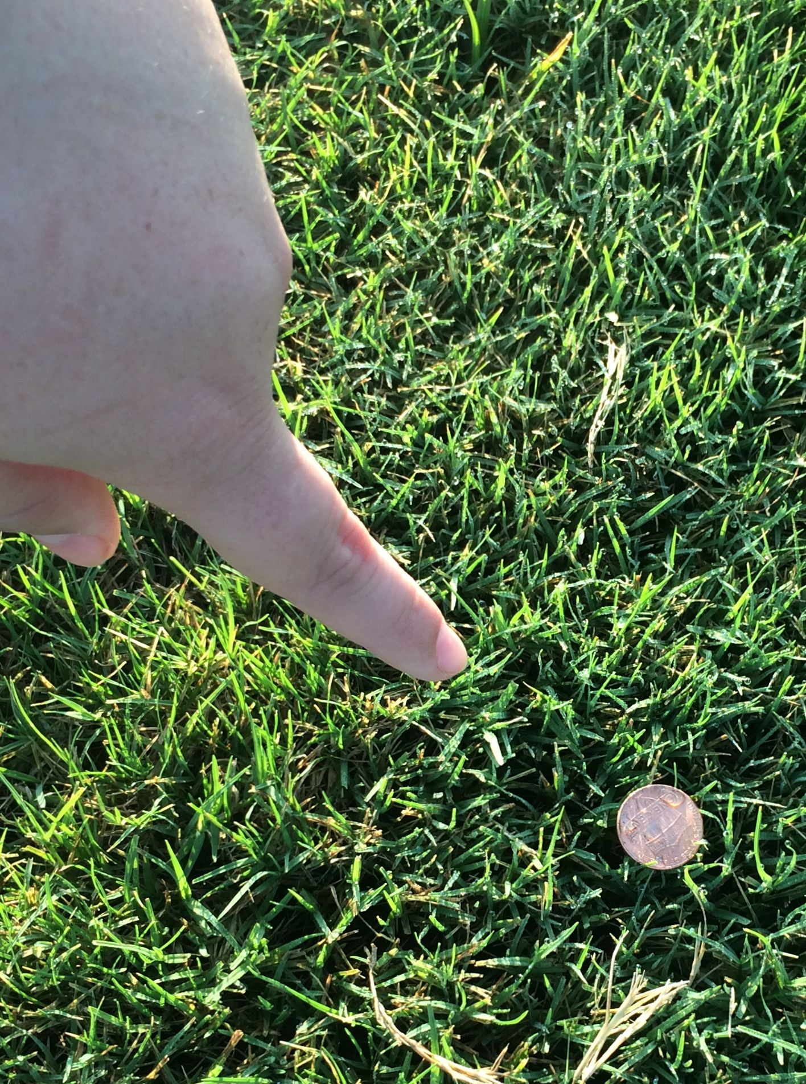
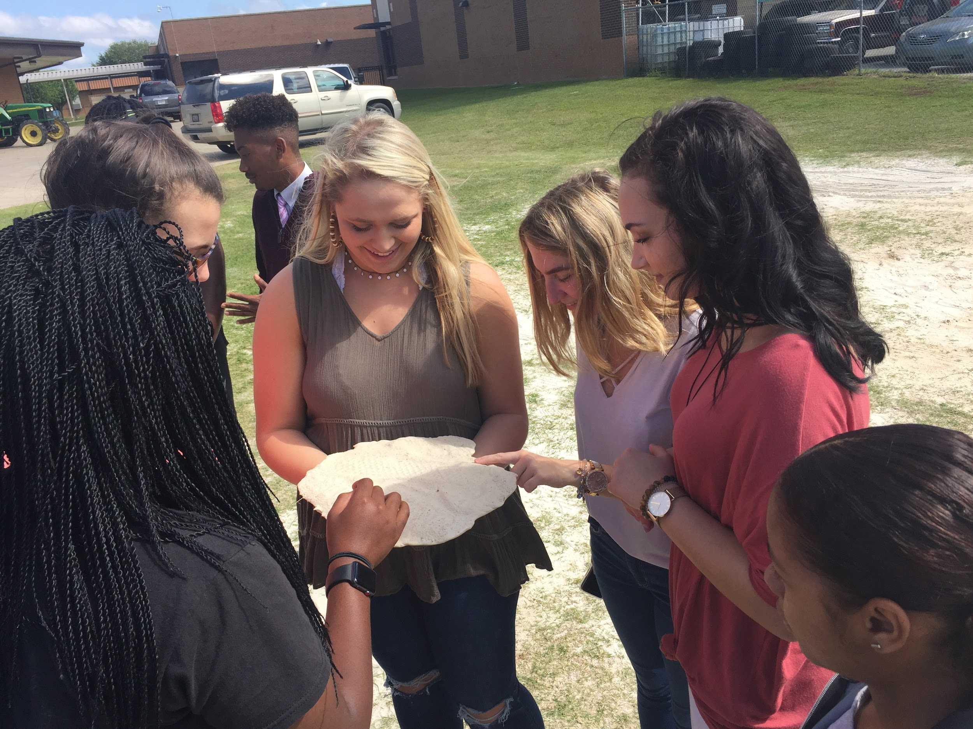
Hands On
Pennies in a Field
Castings
Notes:
Hands on work is uniquely relevant because THEY did it. It has an added importance because it is THEIR shoe print, THEIR fingerprint, THEIR blood stain, instead of some random sample.

Slide 14
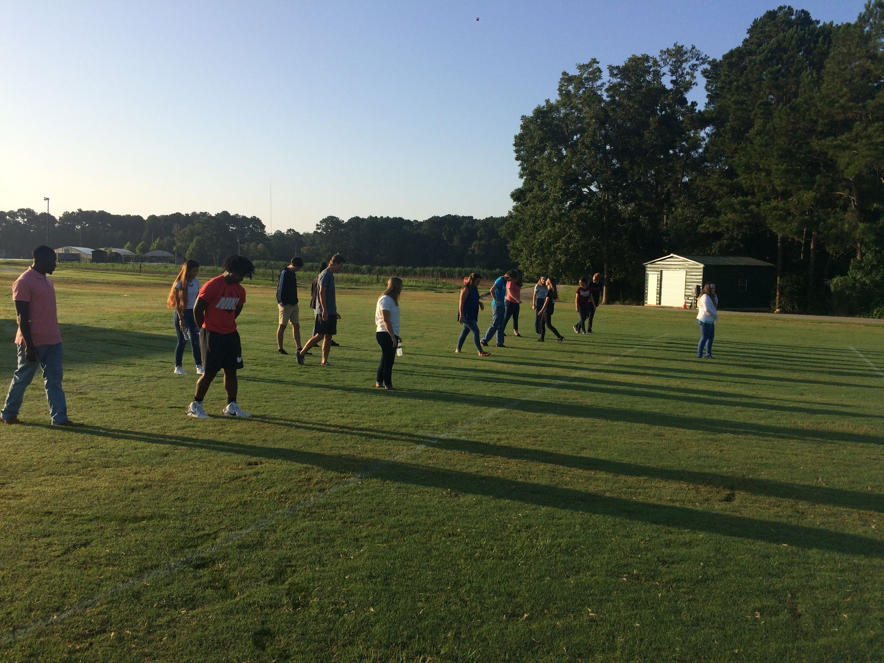
moooooooooooo

Slide 15
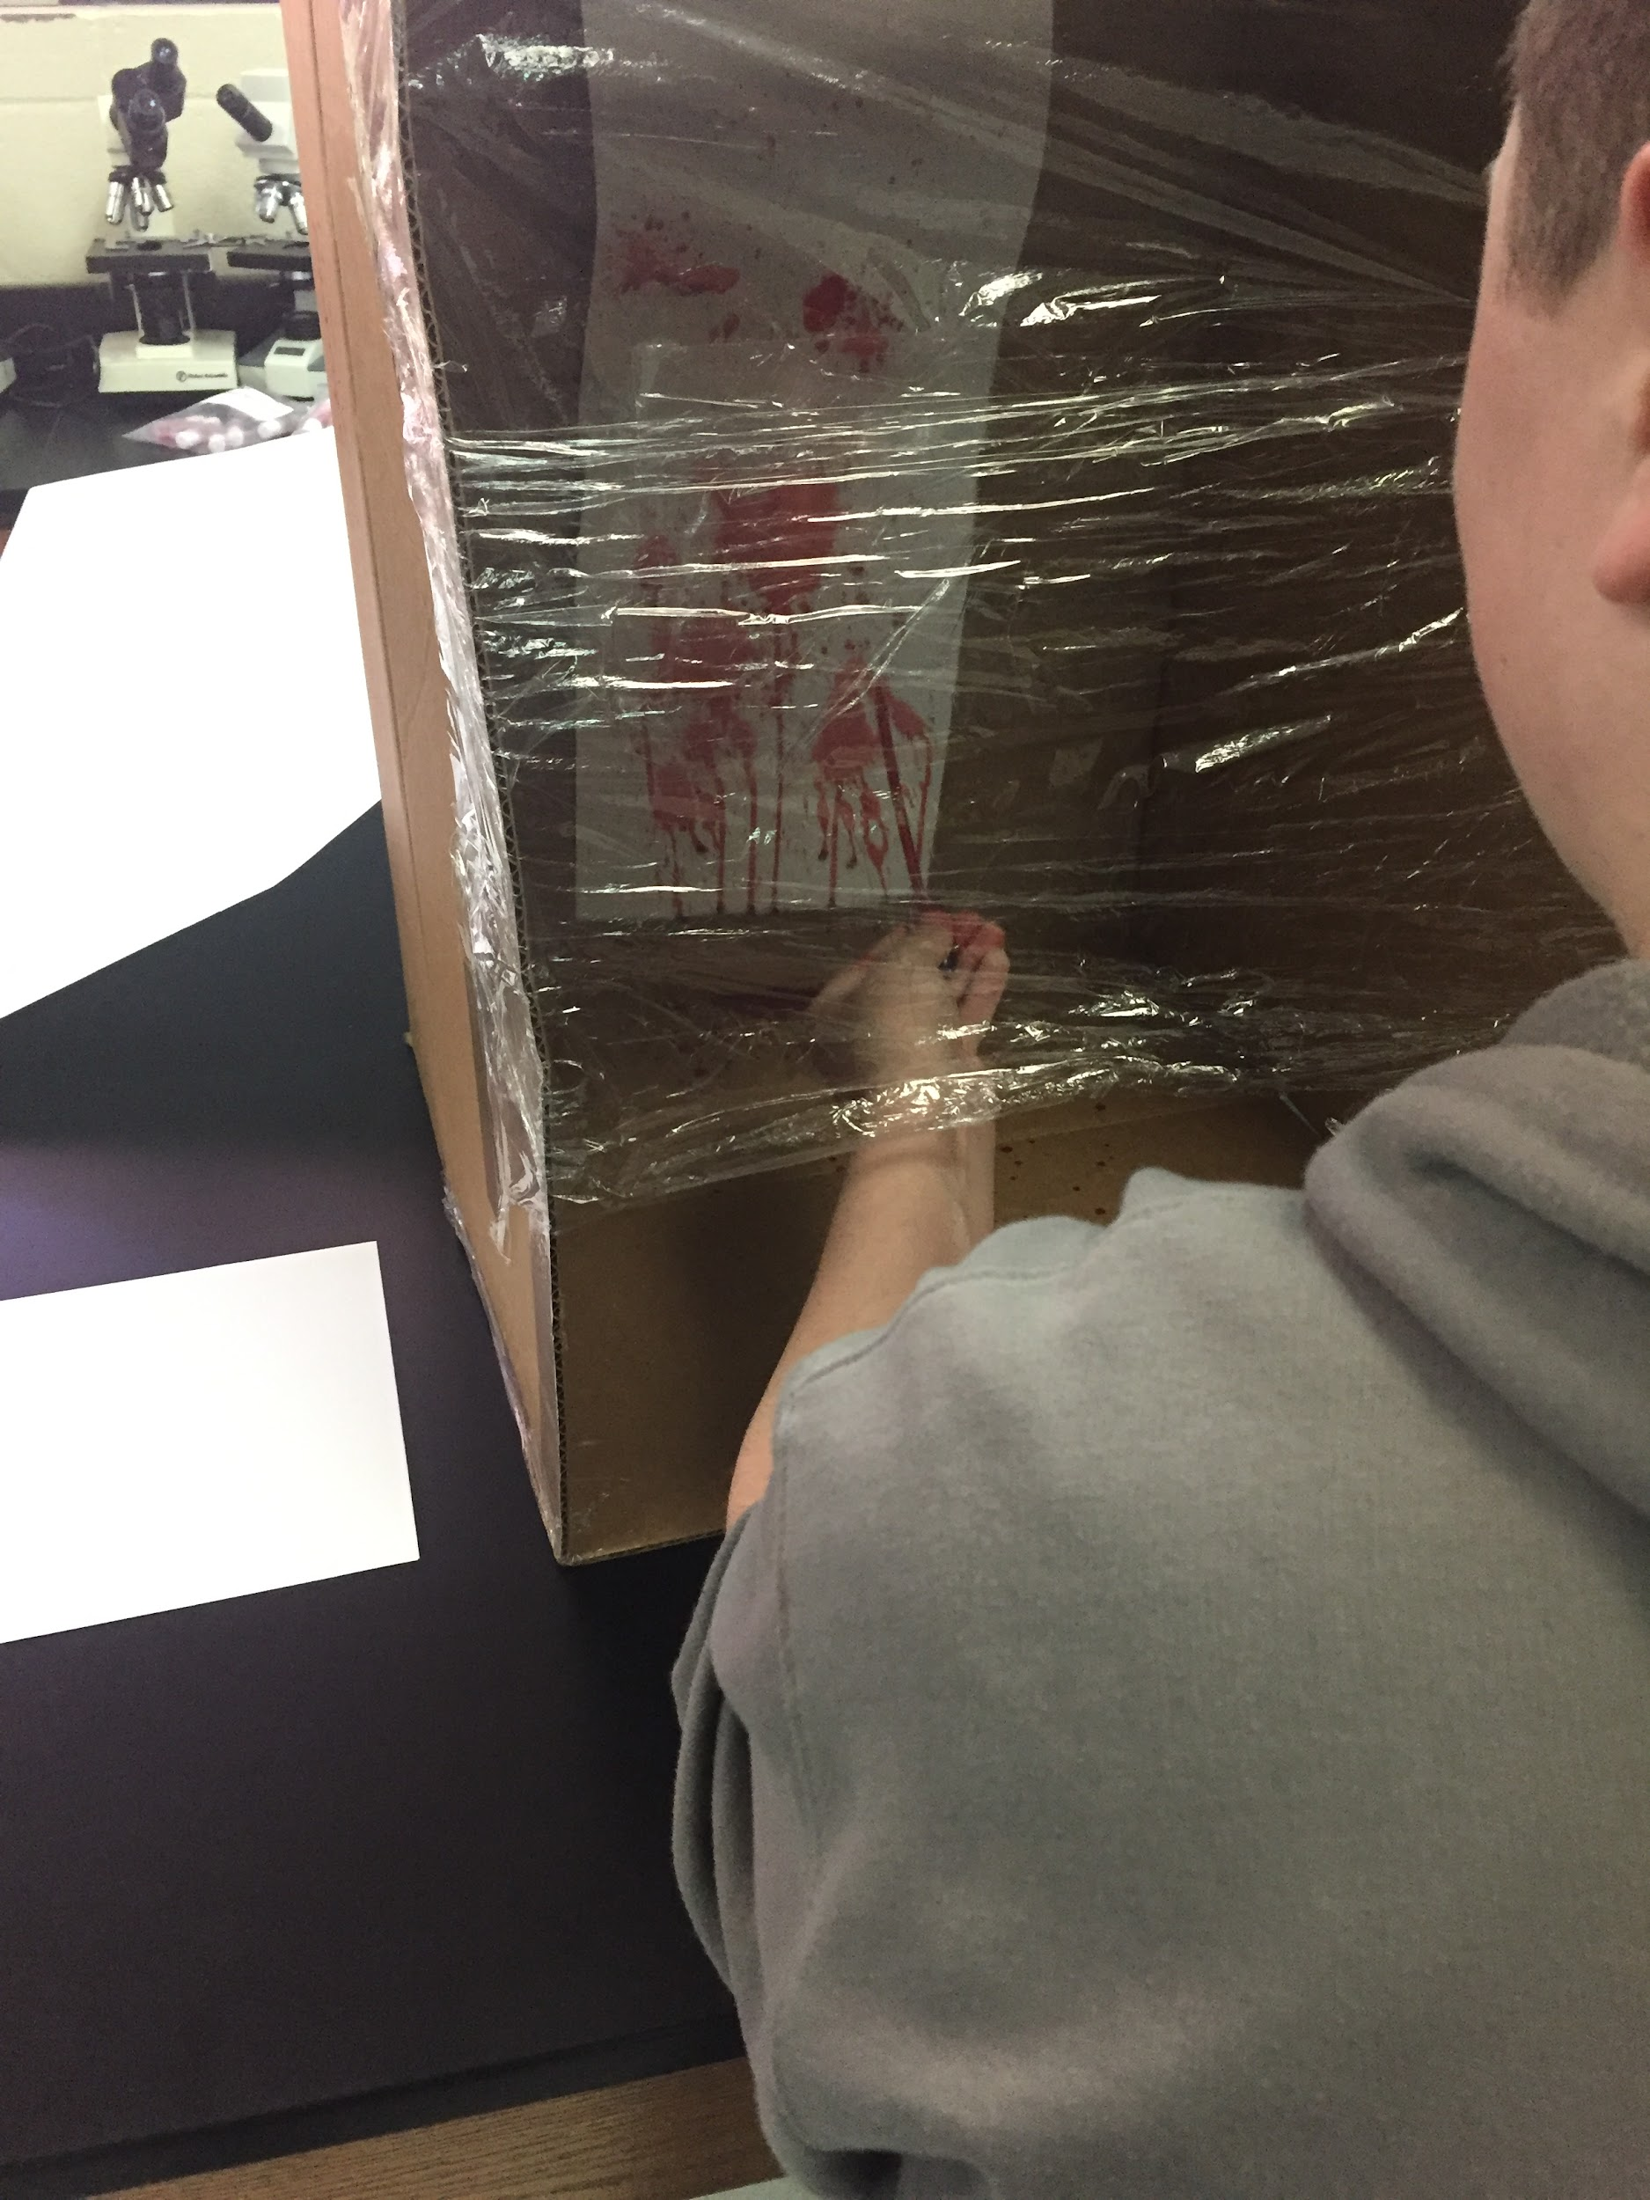
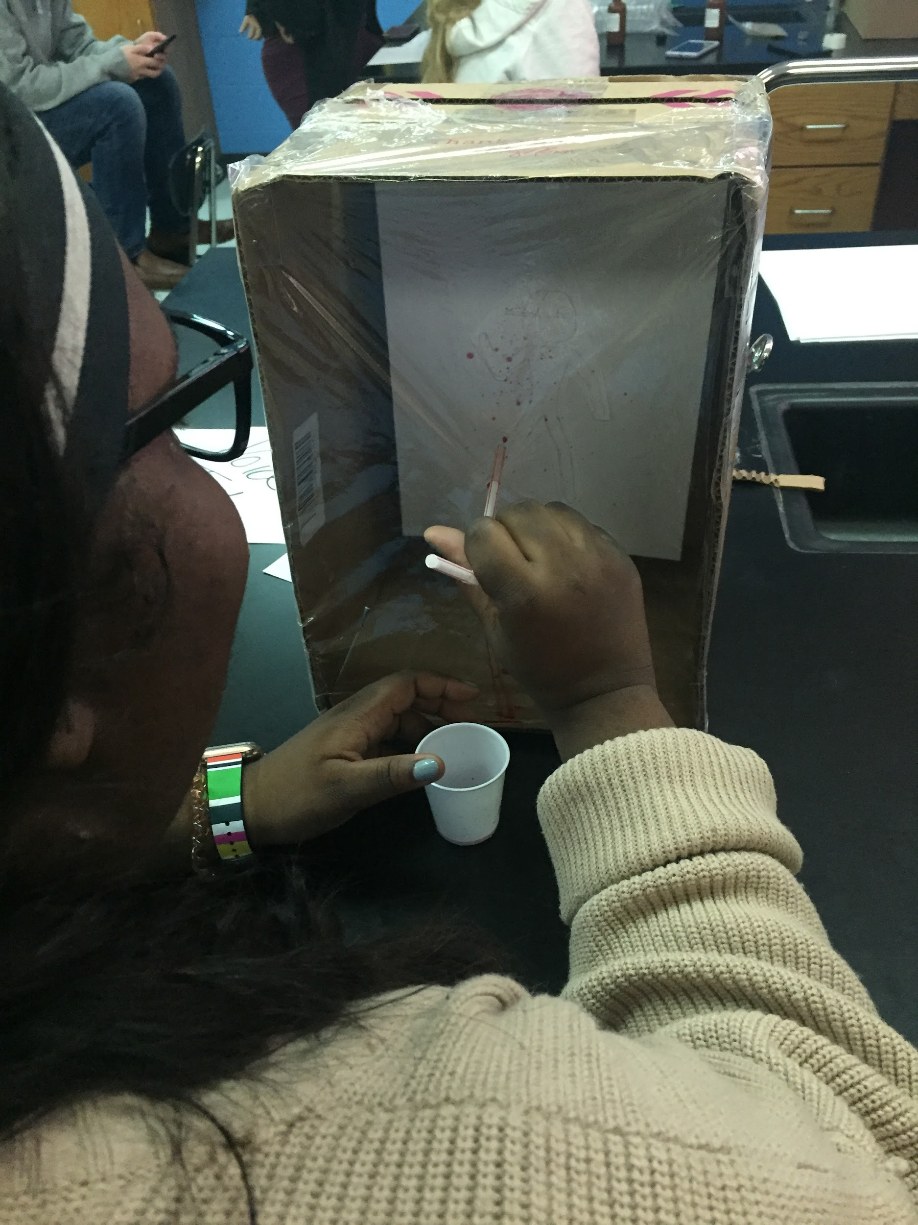
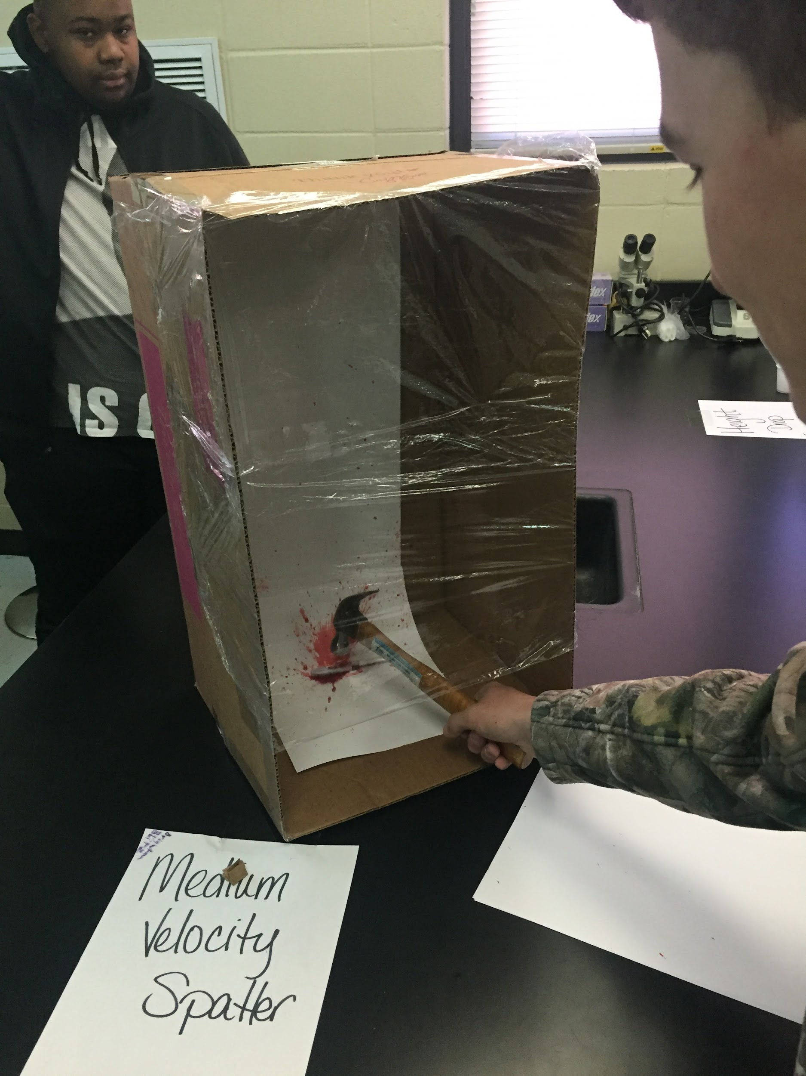
Arterial Spray The Void Medium Velocity

Slide 16
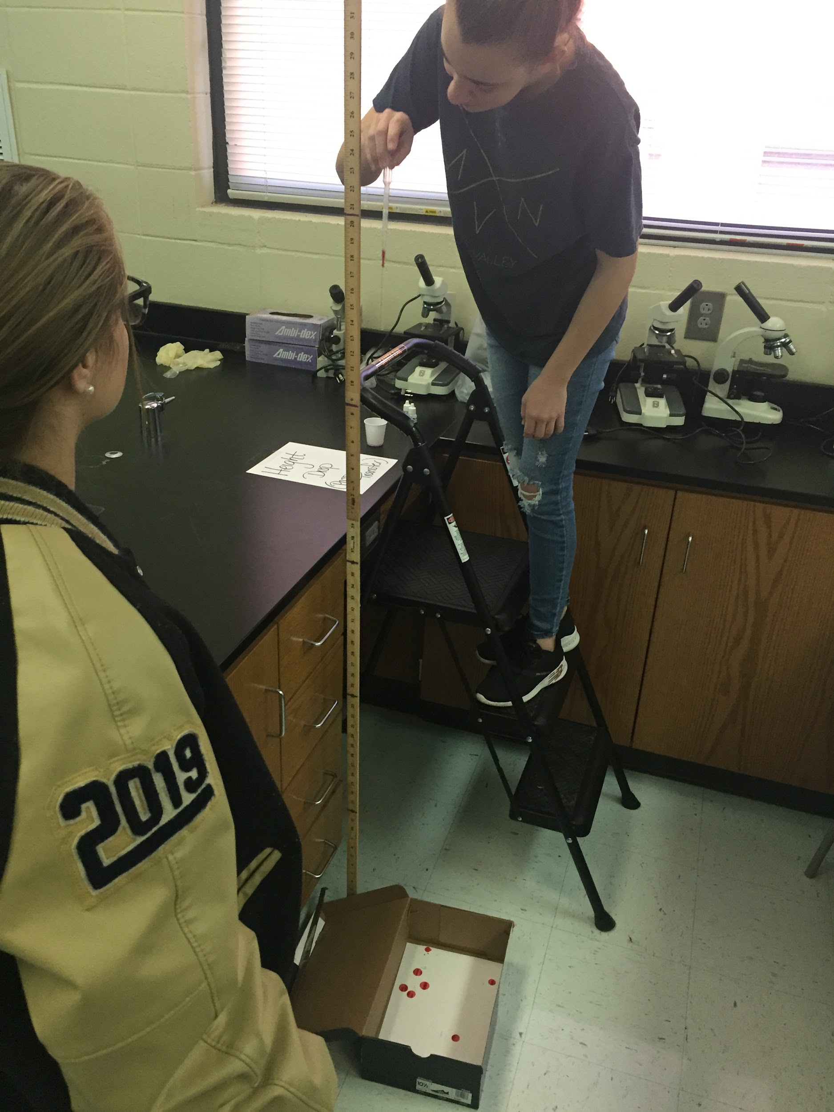
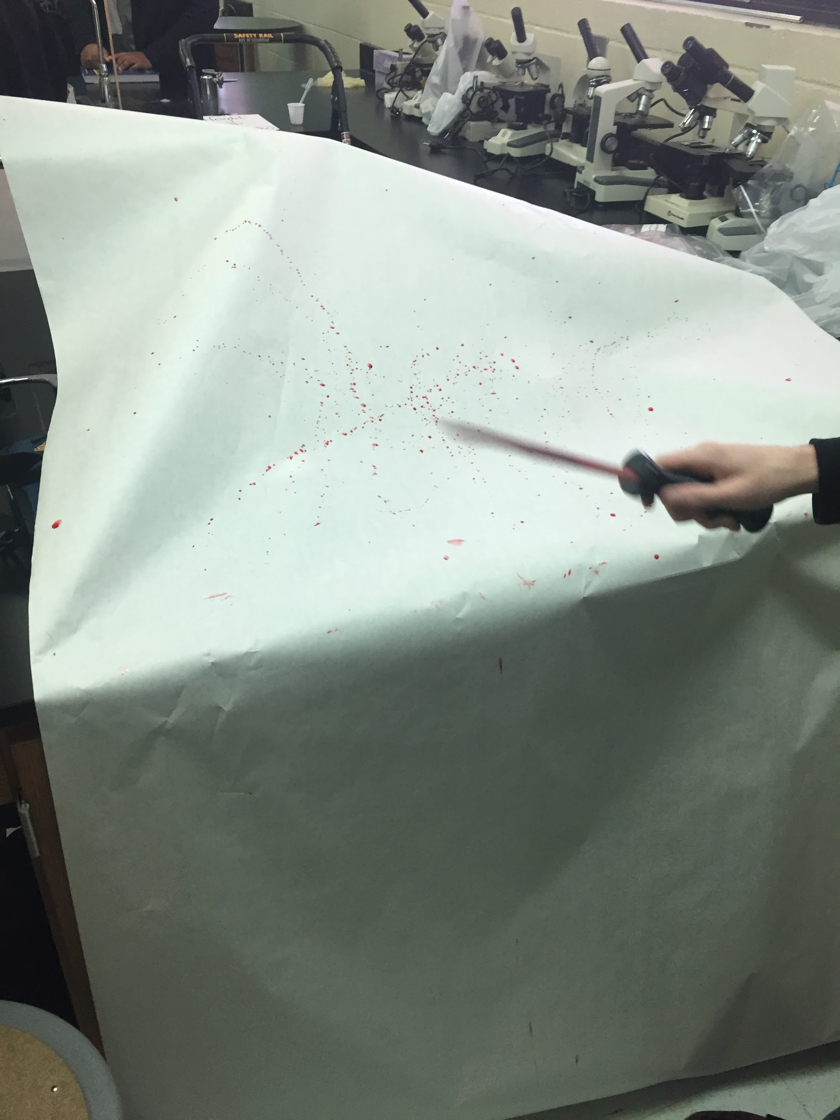
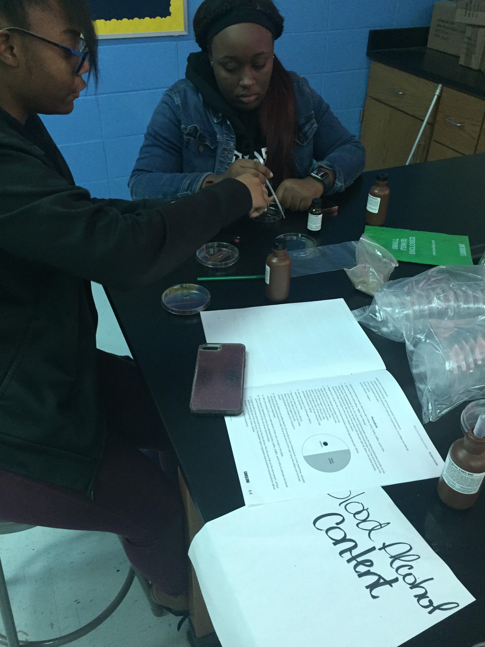
Passive Cast Off Blood Alcohol
Transfer Content

Slide 17
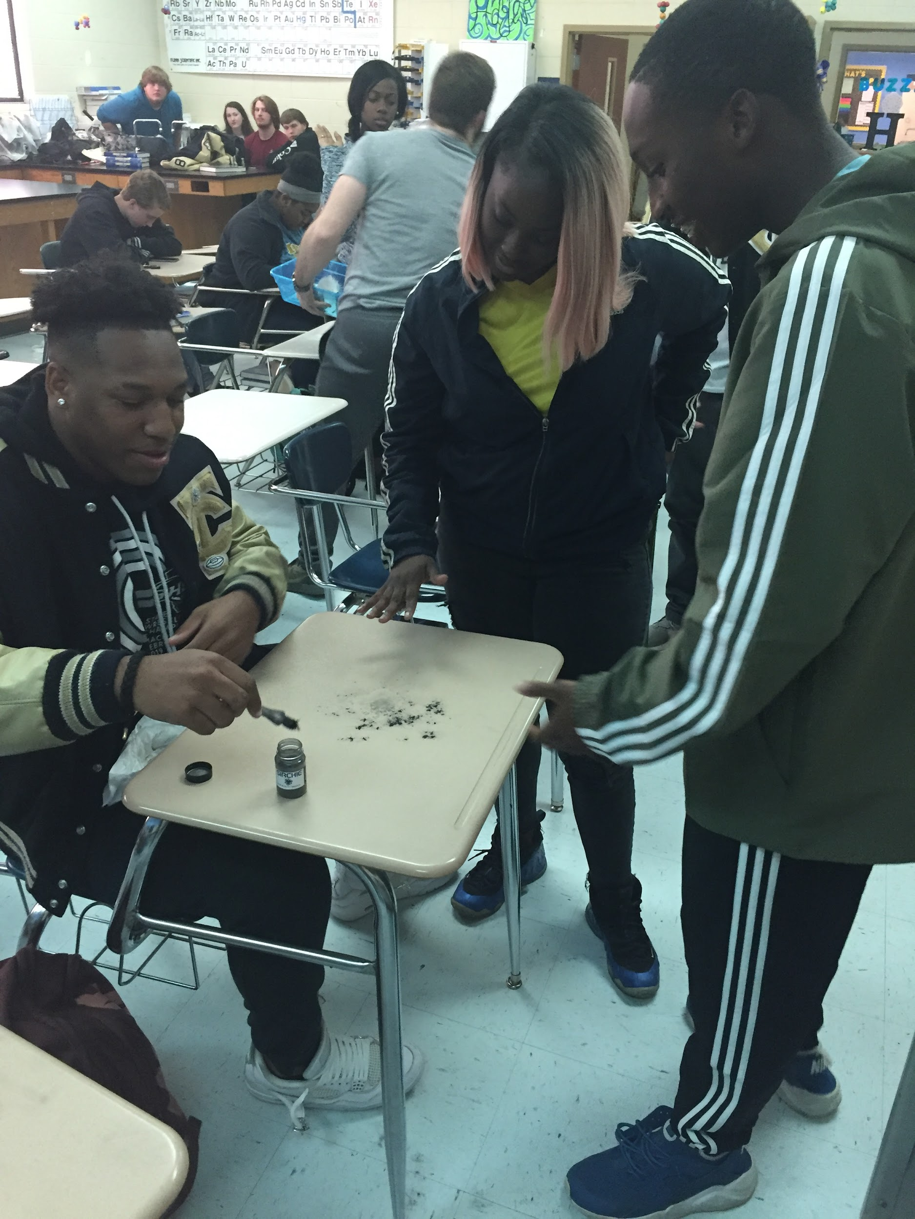
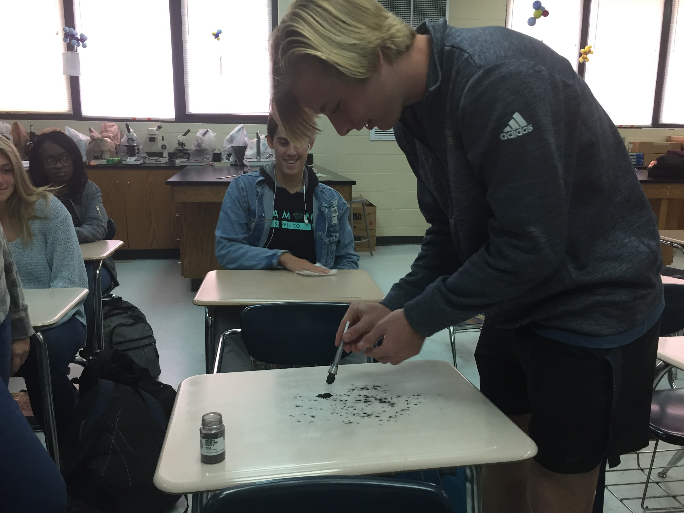
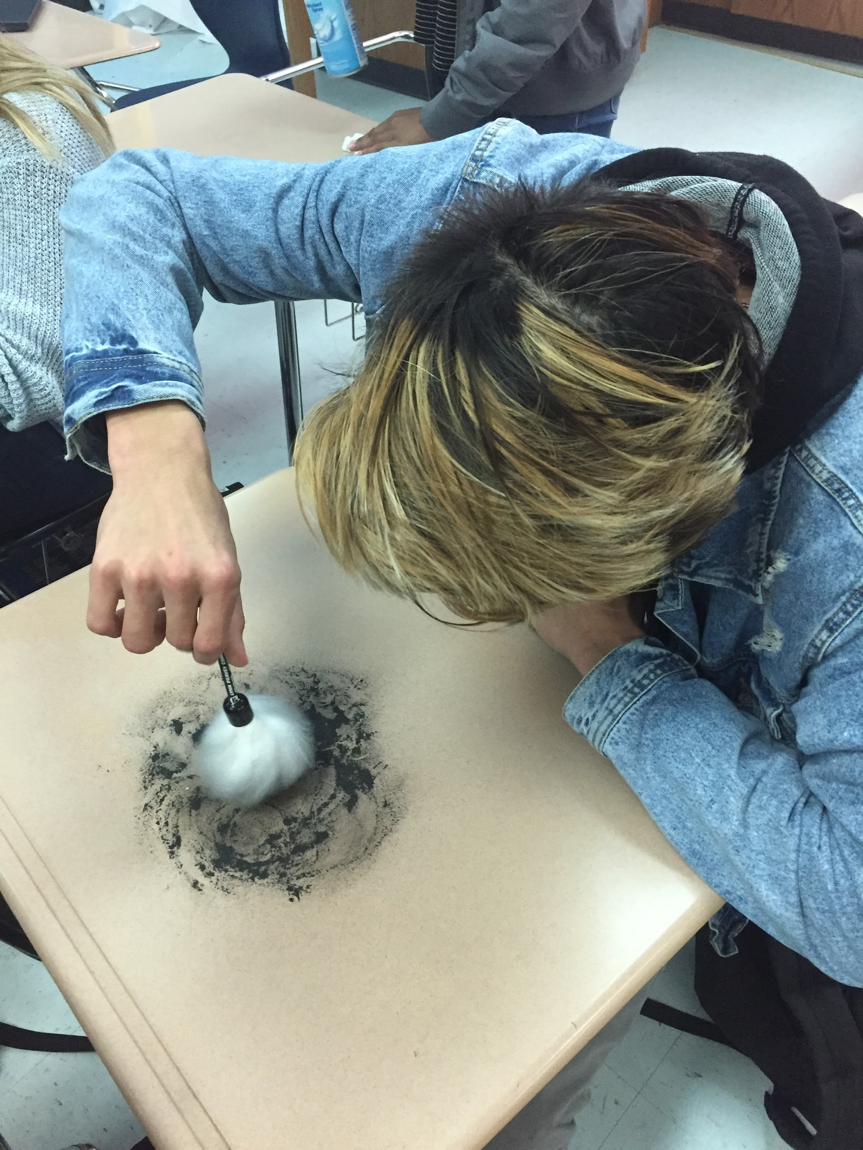
Fingerprinting
Notes:
I let them mess up! I let them start with their desks, too much powder, too much pressure, I let them make mistakes, because that is how they learn. They also learn just how gross their desks are.

Slide 18
Case Studies
It is not enough to just read about a case.
Why is it relevant to the students / content?
  Scott Peterson = first impressions.
  OJ Simpson = media bias.
  George Zimmerman = perspective and bad laws.
  Swamp Murders = it can happen here, too.
Journal
Notes:
The opinion of Scott Peterson changes dramatically through 3 photographs.
Not a single student, in 3 years, male or female, believes OJ is innocent. They have even asked how he was not convicted. Enough time has passed that this generation does not know his fame. However, they have no problem saying “Free Melly”, a convicted murderer who admitted to killing 2 people in a song, leading to his arrest for those two murder.
George Zimmerman leads to the conversation of important concepts becoming bad laws and listening to different opinions.

Slide 19
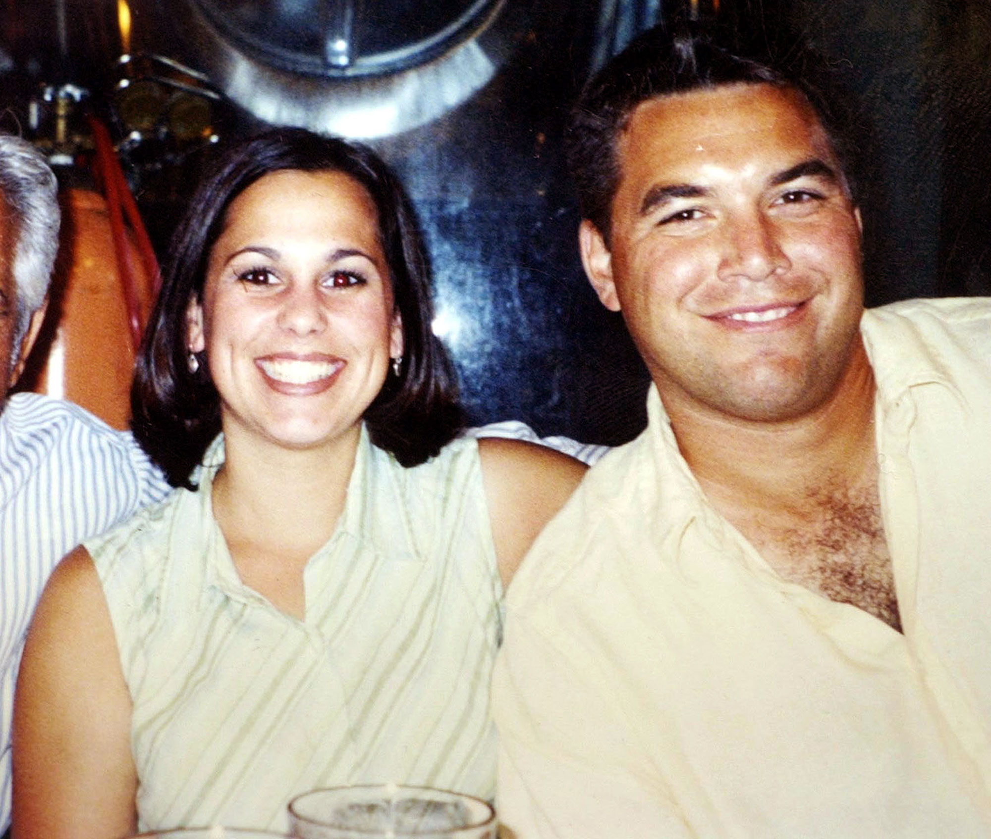
Notes:
Photo credit: https://www.google.com/search?q=scott+peterson&source=lnms&tbm=isch&sa=X&ved=2ahUKEwjm7eiu5pnmAhVxUt8KHdAwDF4Q_AUoAnoECA0QBA&biw=1680&bih=907&safe=active&ssui=on#imgrc=FjMLbUOCC7tUZM:

Slide 20
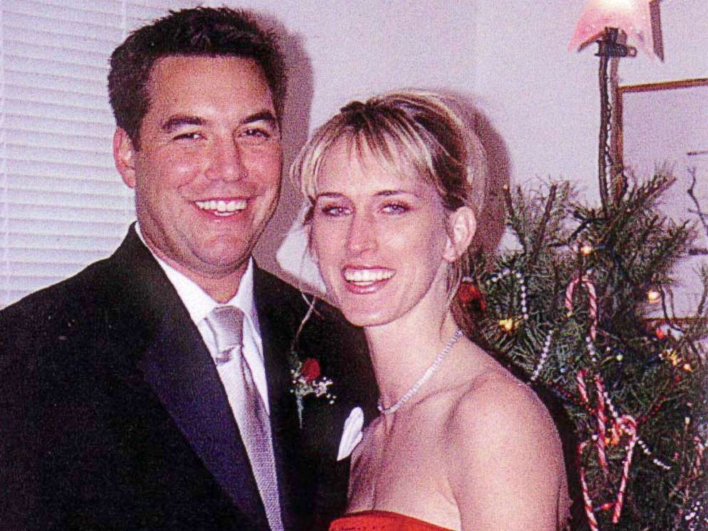
Notes:
Photo credit: https://abcnews.go.com/US/amber-frey-remembers-recorded-calls-scott-peterson-shaking/story?id=49763587

Slide 21
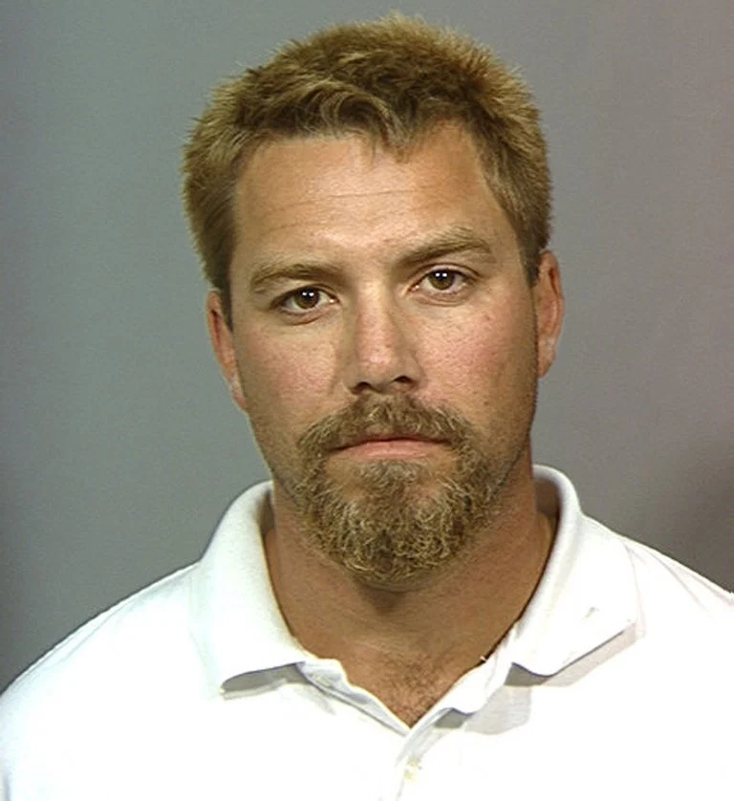
Notes:
Photo credit: https://people.com/crime/laci-peterson-murder-scott-peterson-15-years-missing/

Slide 22


Current Events
My Source
  WALB
  WCTV
  WTXL
  Times Enterprise
  FoxNews
Our Cases
  FSU Hazing Death
  Local Drug Cases
  Kendrick Johnson
  What the kids find...
Notes:
Photo credit 1: https://www.thechairmansbao.com/top-ten-chinese-idioms-2017-chosen-lessons/
Photo credit 2: https://www.flaticon.com/free-icon/television-microphone-with-stand_78631
While studying DNA, a news article out of Florida highlighted a new bill in the Florida legislature aimed at new DNA testing requirements for old cases.
FSU Hazing Incident, Kendrick Johnson, Coach Massey

Slide 23
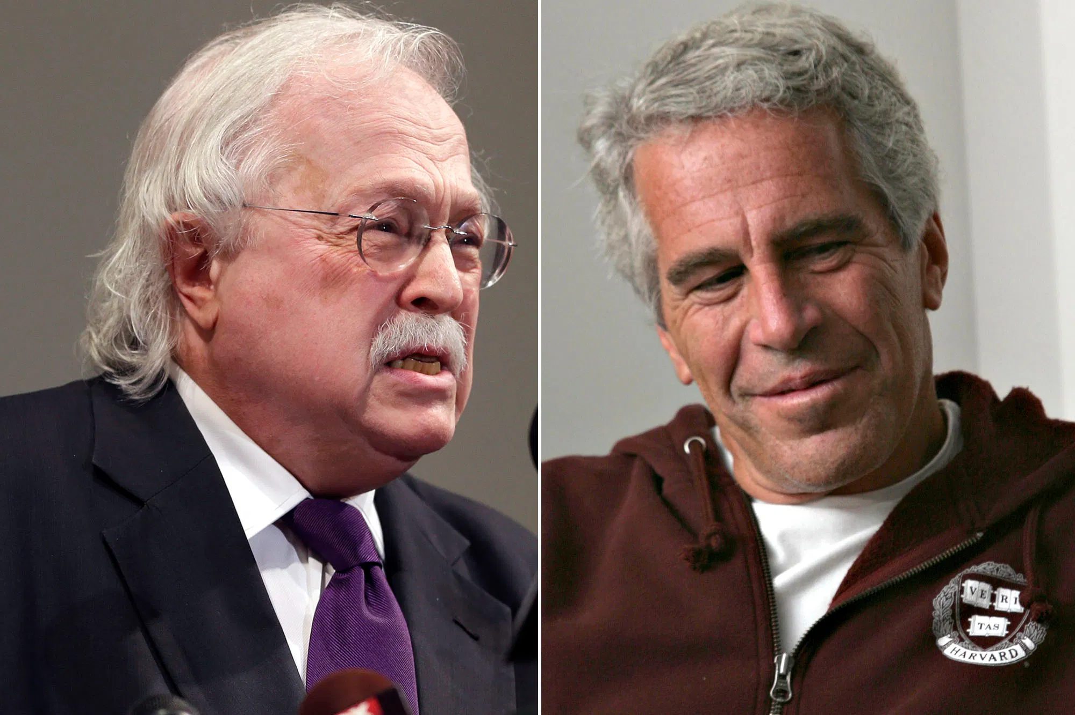
Jeffrey Epstein
Suicide or Homicide?
Presence of petechial hemorrhaging?
Lack of lividity in the legs?
Broken hyoid bone?
Notes:
Photo credit: https://nypost.com/2019/10/30/famed-pathologist-michael-baden-says-jeffrey-epsteins-death-was-homicide/
If our students have learned enough about cause of death and manner of death, they should be able to examine the evidence in their case for themselves, aside from the conspiracy theories and the statements made by the authorities.
I want my students to be able to examine cases in the media and know when they are being told the truth and when they are not being told the truth.
Jeffrey Epstein had a broken hyoid bone, no lividity in the legs and petechial hemorrhaging, which Dr. Michael Baden said is consistent with homicidal strangulation. Had he actually hung himself he would have had a broken C2 vertebrae, and lividity in his legs from hanging in the death position.

Slide 24
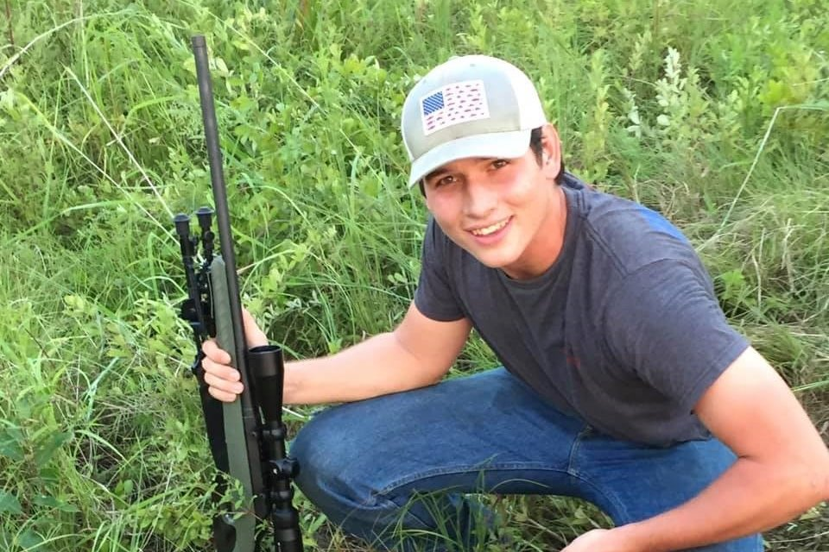
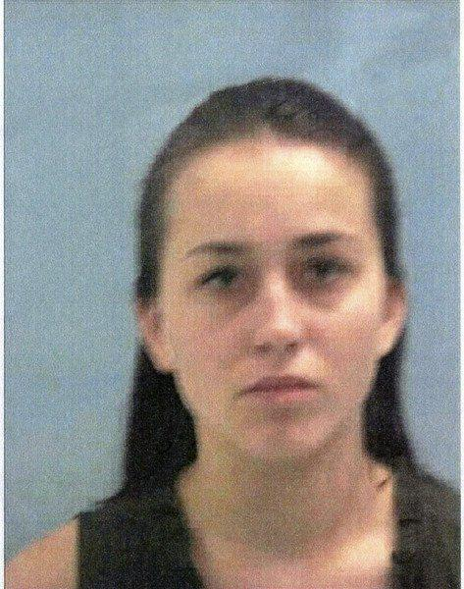
Too Close To Home
Notes:
Anna McBride admitted in her plea bargain to driving 116.8 mph when she struck the back of Levi Knop’s truck, causing him to run off the road and into a tree, breaking his femur and causing him to bleed out. She was sentenced to 15 years, 3 of which must be served in a state prison, she lost her licence for 15 years, she can have no contact with anyone connected to the case for 15 years, she cannot leave the state of Georgia for 15 years, she has a $10K fine, she must perform 500 hours of community service and 150 of those hours must be telling younger students of the dangers of reckless driving.
Photo 1: https://www.gofundme.com/f/levi-knop
Photo 2: https://www.timesenterprise.com/news/local_news/new-indictment-issued-for-fatal-wreck-case/article_d1e6b218-a763-593a-88ed-7df4bf74d713.html

Slide 25
New Uses in Forensics
Mission Declassified: “The Lindbergh Kidnapping”
Mission Declassified: “Escape from Alcatraz”
Mission Declassified: “The Axeman of New Orleans”
9/11 Identifications
Nazis in South America after WWII
America Unearthed
Who Killed Rasputin?
The Innocence Project

Slide 26
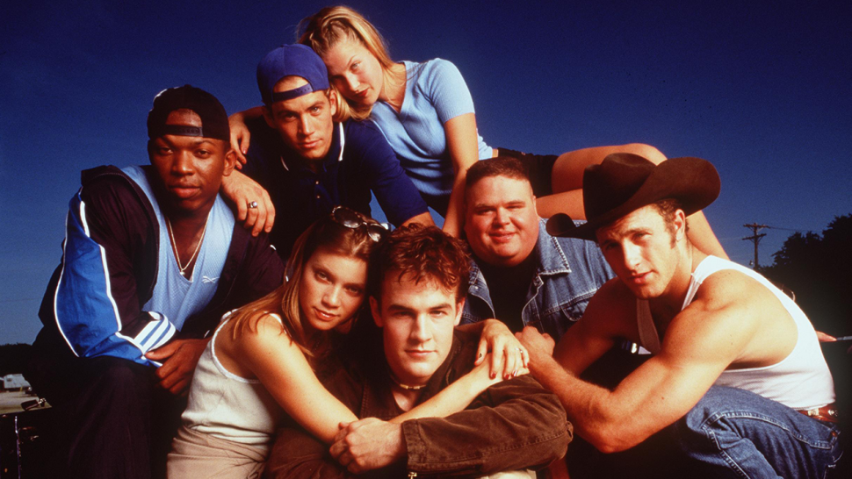
Know it. Be comfortable.
Notes:
In the 1990’s football / coming of age film “Varsity Blues”, the science teacher has the students say “penis, penis, penis, vagina, vagina, vagina” to get their giggles out before having the Sex Ed talk. Granted, I don’t actually have them say it, but before we talk about serology, and especially sexual assault, I talk to them about going home, looking in the mirror, saying all the words that make them giggle and getting it out of their system before they come to class.
“You took Accutane twice, if you drink before you are 21, your liver will turn black and it will fall out of your butthole in the middle of class and everyone will know.”
Regardless of your opinion of the 2nd amendment, you have a responsibility to know about ballistics. If you are uncomfortable talking about sexual content, how can you explain a rape kit? If you demonstrate a bias, even if it is your personal conviction, you are limiting their ability to trust you and therefore learn from you.
Photo Credit: https://www.etonline.com/varsity-blues-tv-series-is-in-the-works-at-quibi-128424

Slide 27
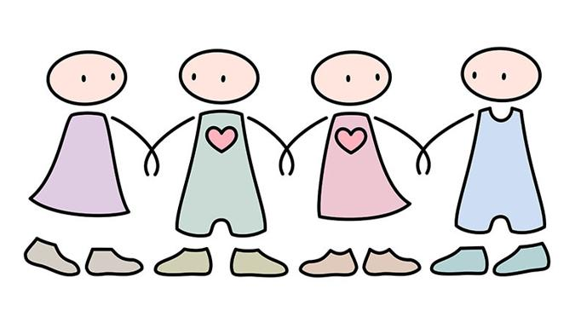
Safe Relationships
My students trust me to tell them the truth
Share realistic goals
Mean what you say and say what you mean
If they ask, I do my best to answer, professionally
Notes:
Photo credit: https://www.clipart.email/clipart/social-relationship-clipart-44044.html
We have “closed door” moments. Although I would never say anything to them that I would not say if my principal or superintendent were in the room, they do not necessarily realize that. Therefore, “closed door” moments give them a feeling of being an insider, something that does not leave the room, an honest moment.
Protect them = Darian’s question about getting pulled over
While discussing cases, chosen by the students, I had to explain sodomy because it was a conviction they were unfamiliar with and I could not just say “look it up”.
If you demonstrate a bias, even if it is your personal conviction, you are limiting their ability to trust you and therefore learn from you.

Slide 28
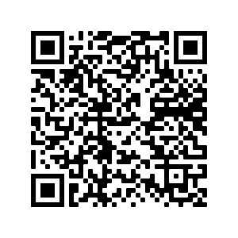
My Contact Information
Bethany Hayes
Thomas County Central High School
bhayes@tcjackets.net

